Slide 1
Report
By Ali Sedaghi

Slide 2
Dataset

Slide 3
Image and Label extraction
Link to Colab
Saved to my github repository
https://github.com/nikomadol/datasets/blob/main/FER-2013/fer-2013-images.npy
https://github.com/nikomadol/datasets/blob/main/FER-2013/fer-2013-labels.npy

Slide 4
Landmark extraction with Dlib
Link to Colab
Saved to my github repository
https://github.com/nikomadol/datasets/blob/main/FER-2013/fer-2013-dlib-landmarks-zip.npz
About 70 % of images are without masks
Very slow algorithm
Landmarks and regions both extracted

Slide 5
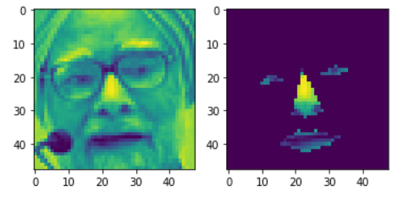

Slide 6
Landmark extraction with MTCNN
Link to Colab
Saved to my github repository
https://github.com/nikomadol/datasets/blob/main/FER-2013/fer-2013-landmarks-zip.npz
Faster than Dlib
More accurate than Dlib
Just Landmark extracted.
Regions are not extracted.

Slide 7
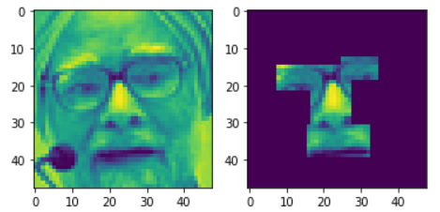

Slide 8
ResNet

Slide 9
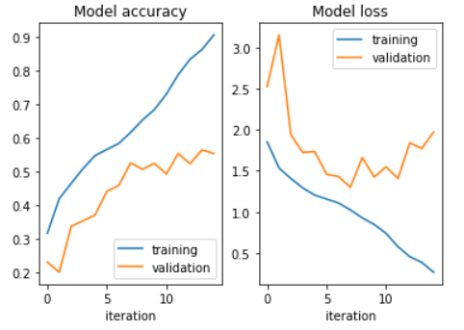
ResNet 50
Train accuracy: 86.0 %
Validation accuracy: 56.5 %
Link to Colab
Input: Original Image

Slide 10
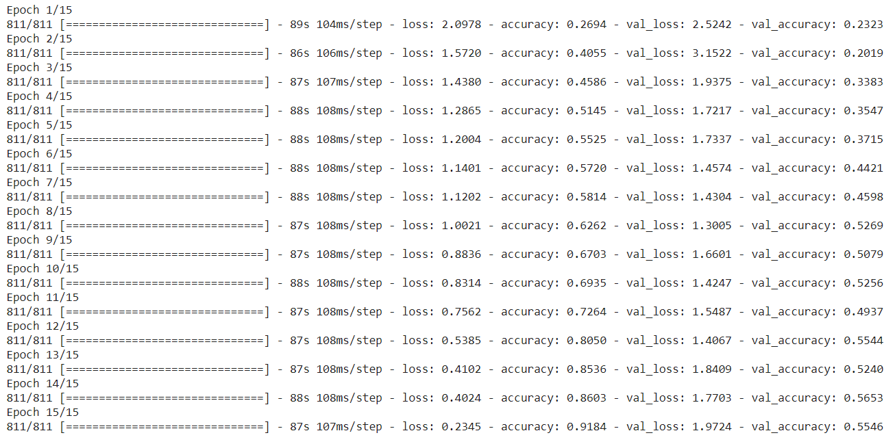

Slide 11
ResNet 56
Train accuracy: 80.0 %
Validation accuracy: 53.5 %
Link to Colab
Input: Original Image

Slide 12
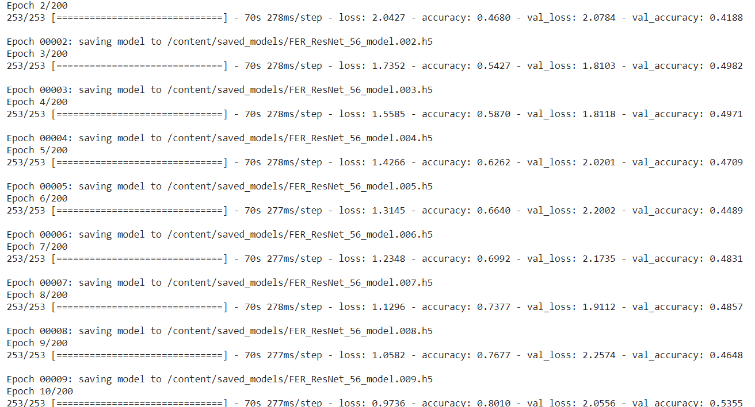

Slide 13
ResNet 56 + Augmentation
Train accuracy: 91.3 %
Validation accuracy: 67.1 %
Link to Colab
Input: Original Image

Slide 14
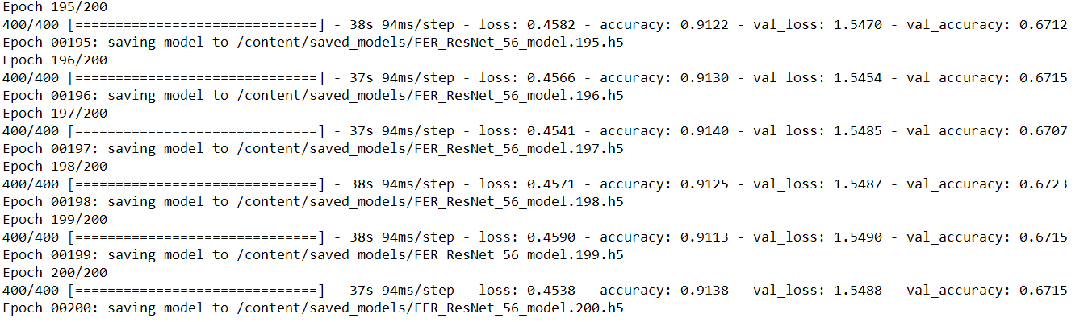

Slide 15
RoI Based ResNet

Slide 16
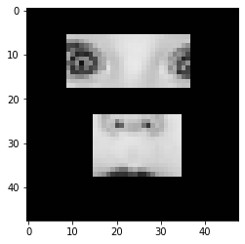
ResNet 56 + RoI MTCNN 2 Regions
Train accuracy: 99.8 %
Validation accuracy: 50.6 %
Link to Colab
* Mr. Jamali’s work
Input: Just RoI Landmarks

Slide 17
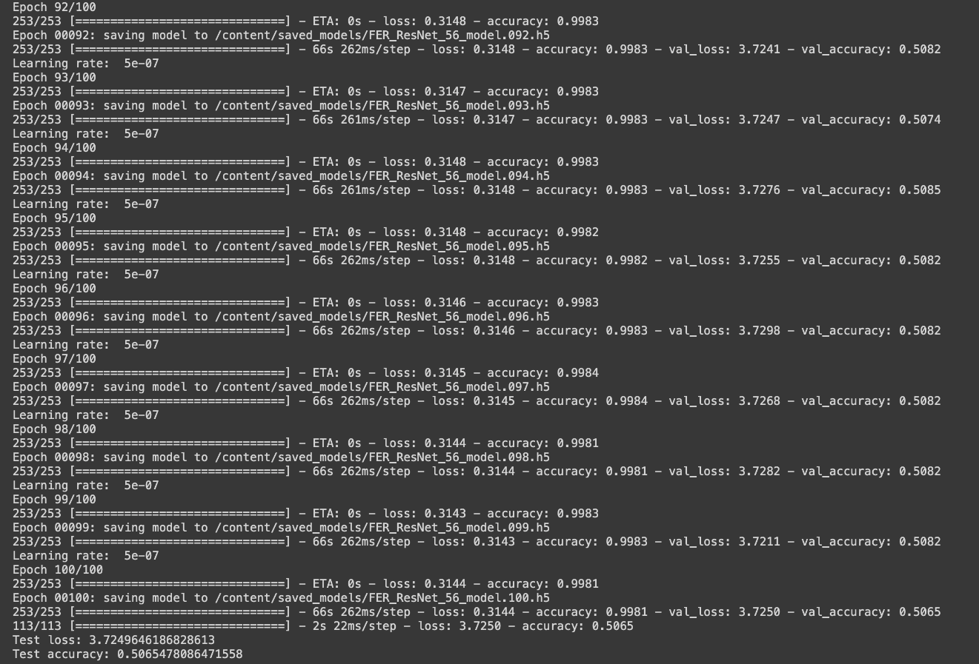

Slide 18
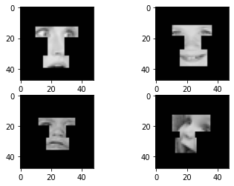
ResNet 56 + RoI MTCNN 3 Regions
Train accuracy: 99.8 %
Validation accuracy: 49.9 %
Link to Colab
* Mr. Jamali’s work
Input: Just RoI Landmarks

Slide 19
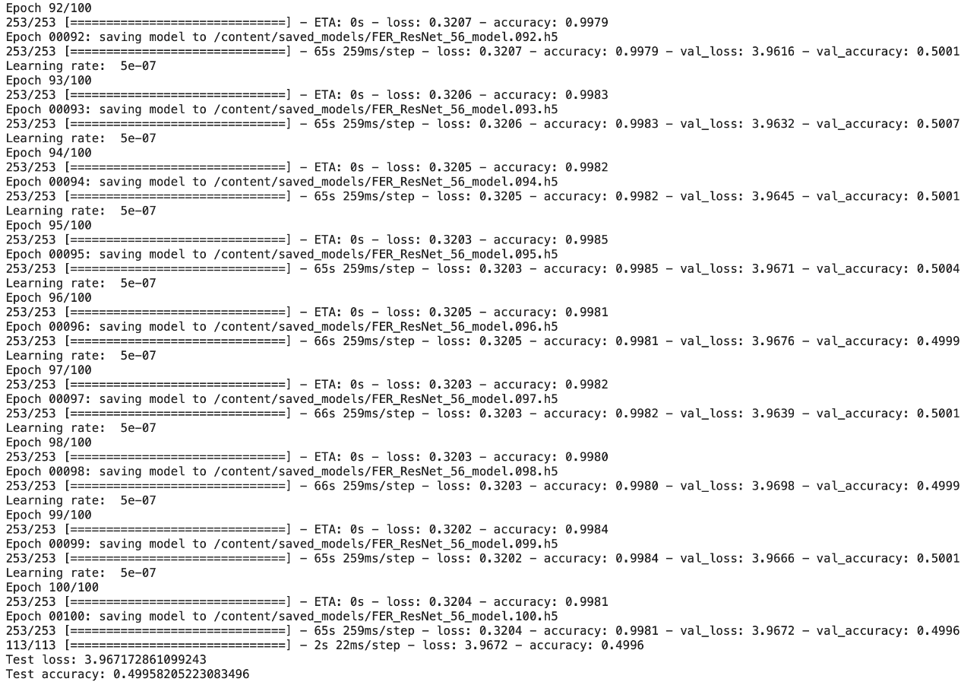

Slide 20
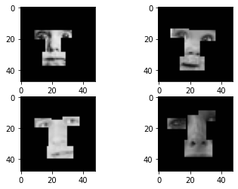
ResNet 56 + RoI MTCNN 4 Regions
Train accuracy: 99.8 %
Validation accuracy: 47.2 %
Link to Colab
* Mr. Jamali’s work
Input: Just RoI Landmarks

Slide 21
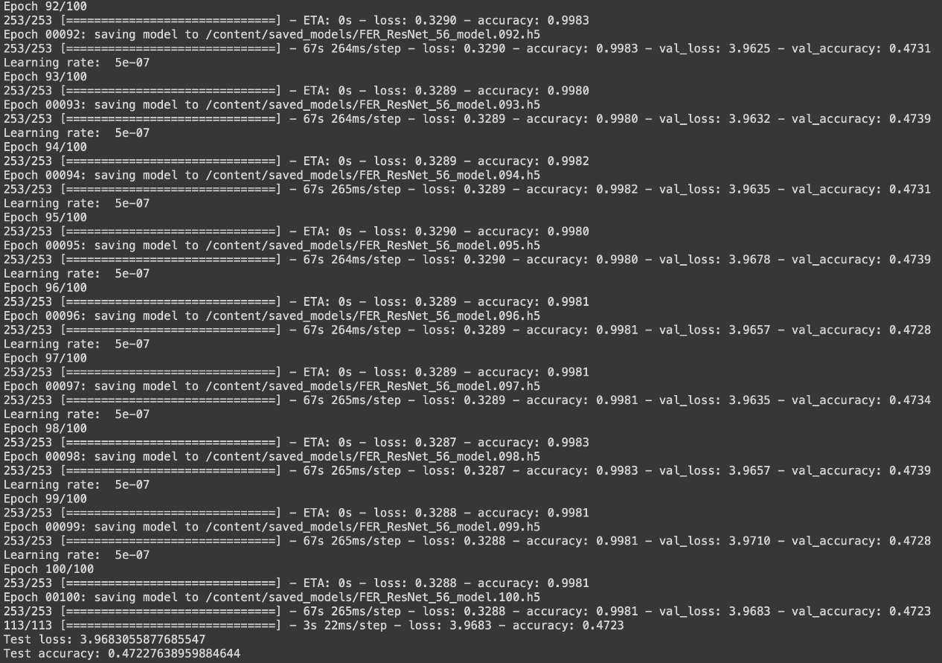

Slide 22
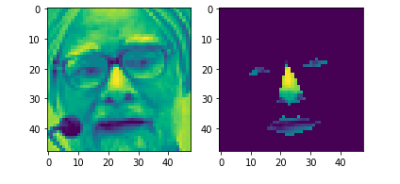
ResNet 50 + RoI Dlib
Train accuracy: 96.4 %
Validation accuracy: 59.6 %
Link to Colab
Input: Original Image + Regions with Dlib

Slide 23
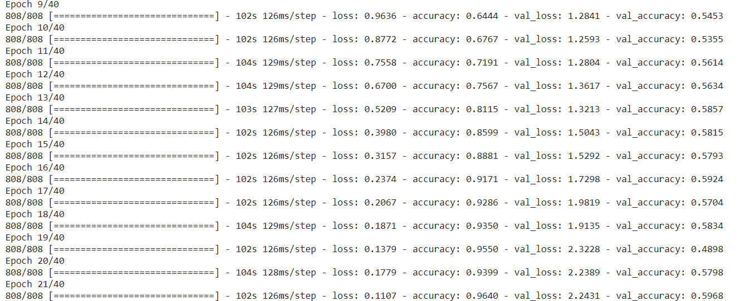

Slide 24
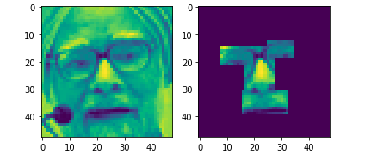
ResNet 50 + RoI MTCNN
Train accuracy: 85.9 %
Validation accuracy: 58.3 %
Link to Colab
Input: Original Image + Landmarks with MTCNN

Slide 25
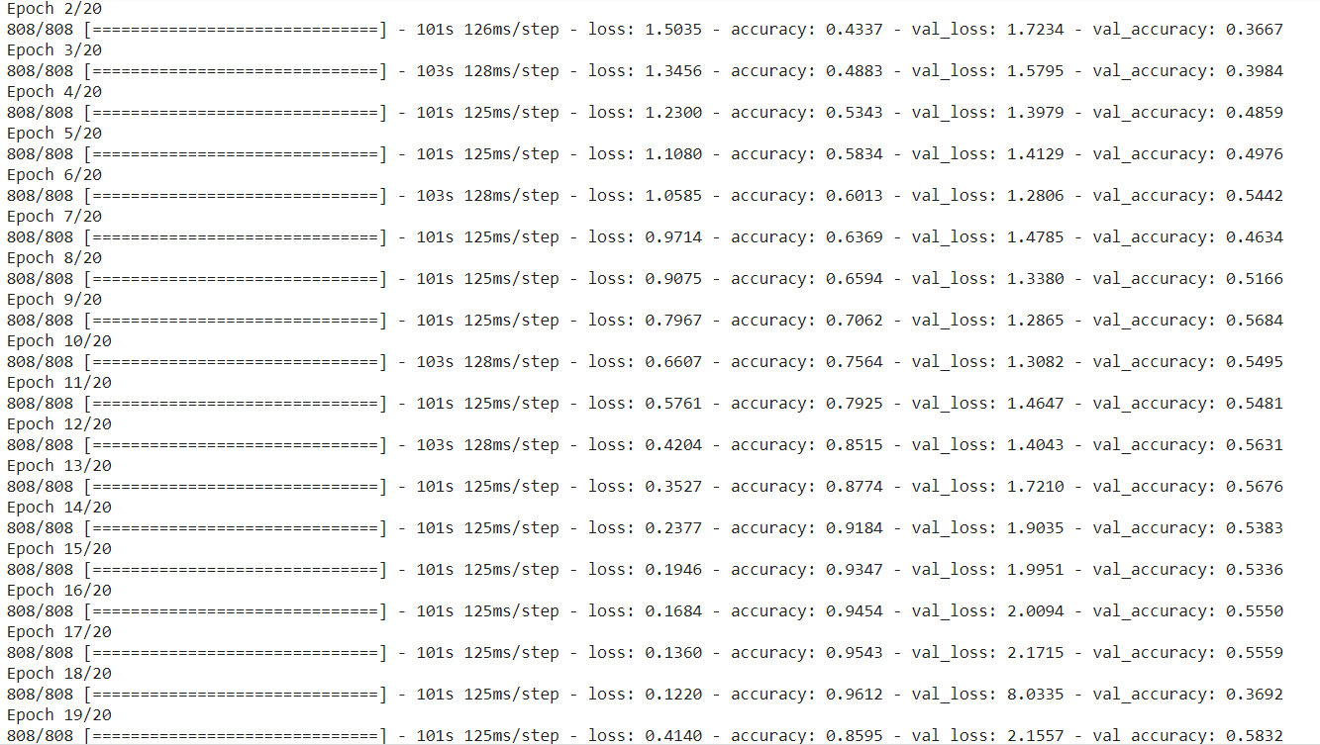

Slide 26
ResNet 56 + RoI MTCNN + Augmentation
Train accuracy: 91.2 %
Validation accuracy: 70.2 %
Link to Colab
Input: Original Image + Landmarks with MTCNN

Slide 27
FaceNet
A Unified Embedding for Face Recognition and Clustering

Slide 28
Introduction
FaceNet is a system that directly learns a mapping from face images to a compact Euclidean space where distances directly corresponds to a measure of similarity.
Face recognition
Face verification
Face clustering
https://arxiv.org/abs/1503.03832

Slide 29
Approach
This method uses a deep convolutional network trained to directly optimize the embedding itself.
In previous deep learning approaches an intermediate bottleneck layer were used.
To train, it uses triplets of roughly aligned matching / non-matching face patches generated using a novel online triplet mining method.
Much greater representational efficiency
state-of-the-art face recognition performance using only 128-bytes per face.

Slide 30
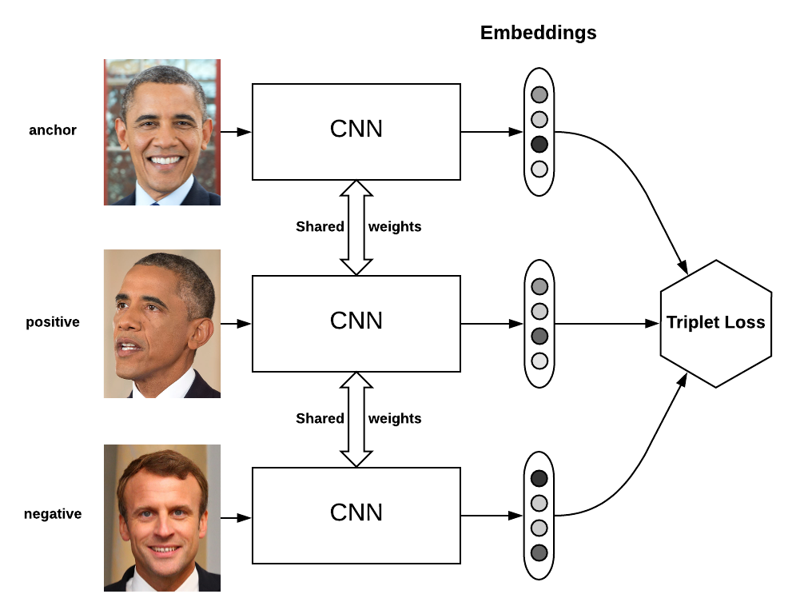
Online Triplet Mining

Slide 31
Datasets
LFW
Youtube Faces DB
CASIA-WebFace
VGGFace2

Slide 32
LFW (Labeled Faces in the Wild)
A public benchmark for face verification, also known as pair matching.
13233 images
5749 people
1680 people with two or more images
Accuracy of 99.63%
Accuracy of previously best published result: ~70%
http://vis-www.cs.umass.edu/lfw/

Slide 33
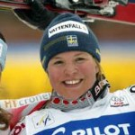
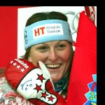



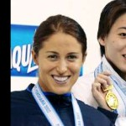




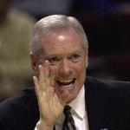

LFW Errors

Slide 34
Youtube Faces DB
Used for face verification and face identification tasks.
3,425 videos of 1,595 different people.
All the videos were downloaded from YouTube.
An average of 2.15 videos are available for each subject.
The shortest clip duration is 48 frames.
The longest clip is 6,070 frames.
The average length of a video clip is 181.3 frames.

Slide 35
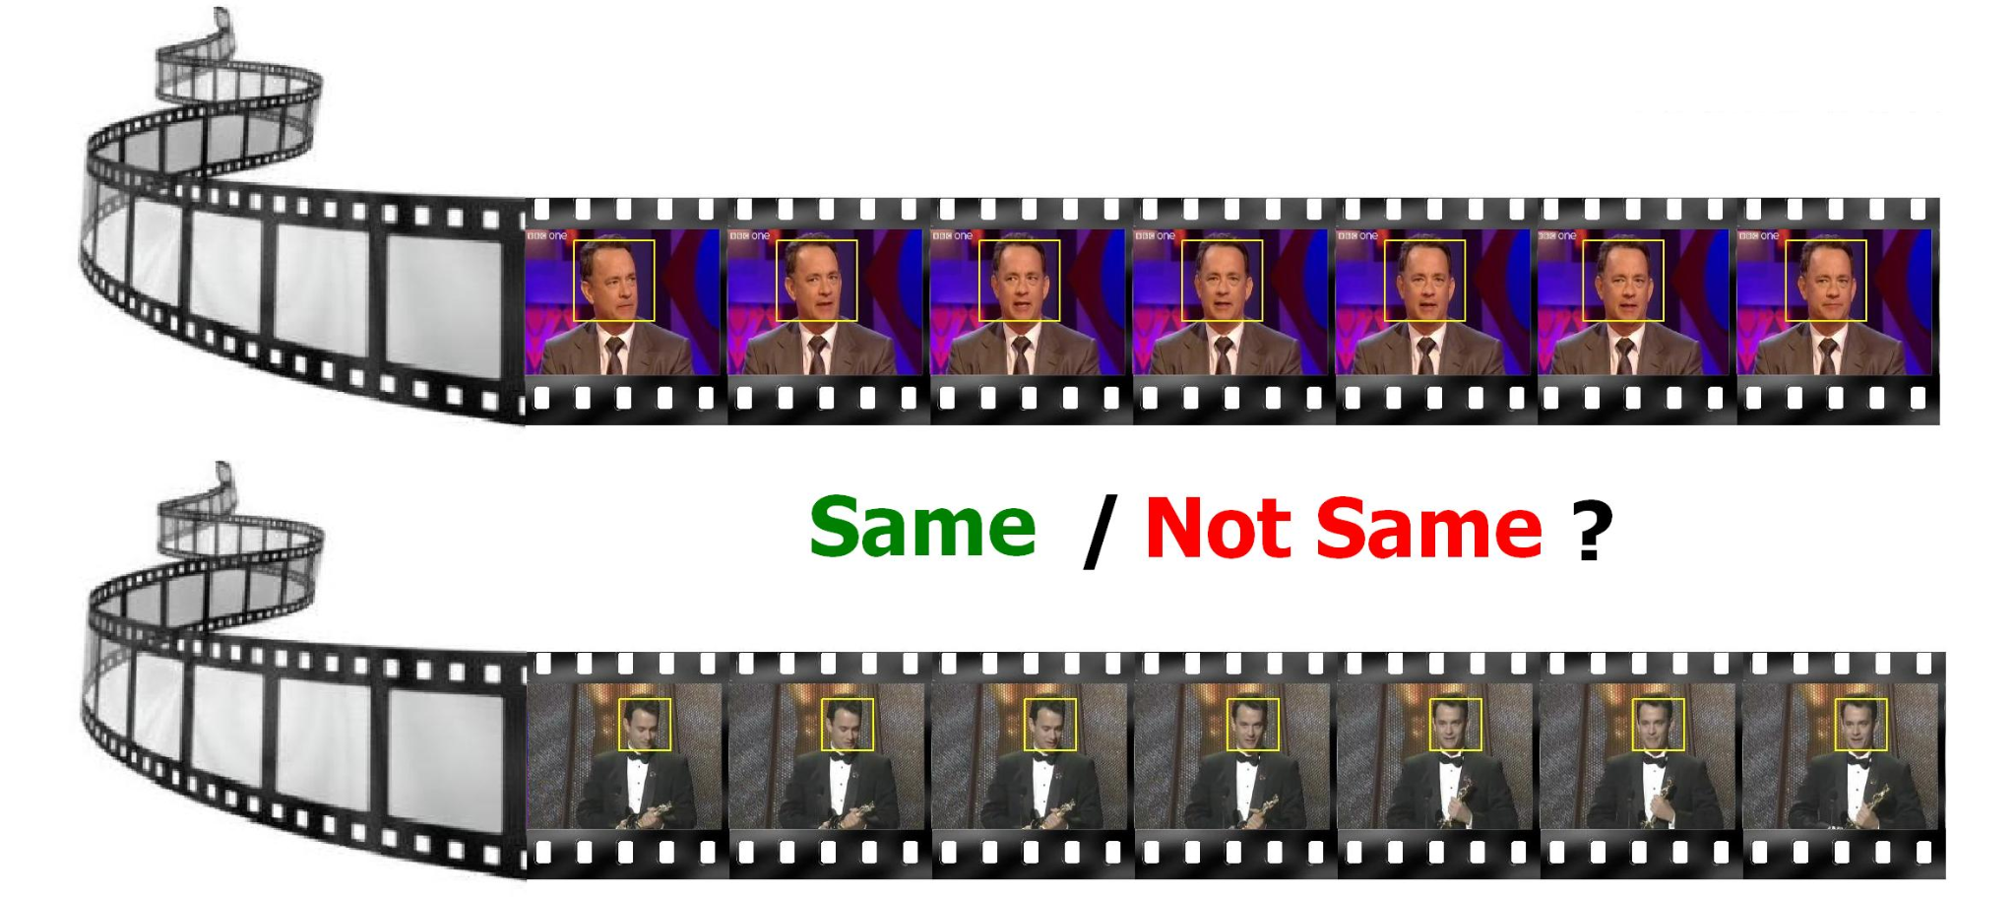

Slide 36
YouTube Faces DB Benchmark (Face Verification)
Accuracy of 95.12%
https://www.cs.tau.ac.il/~wolf/ytfaces/
https://paperswithcode.com/sota/face-verification-on-youtube-faces-db

Slide 37
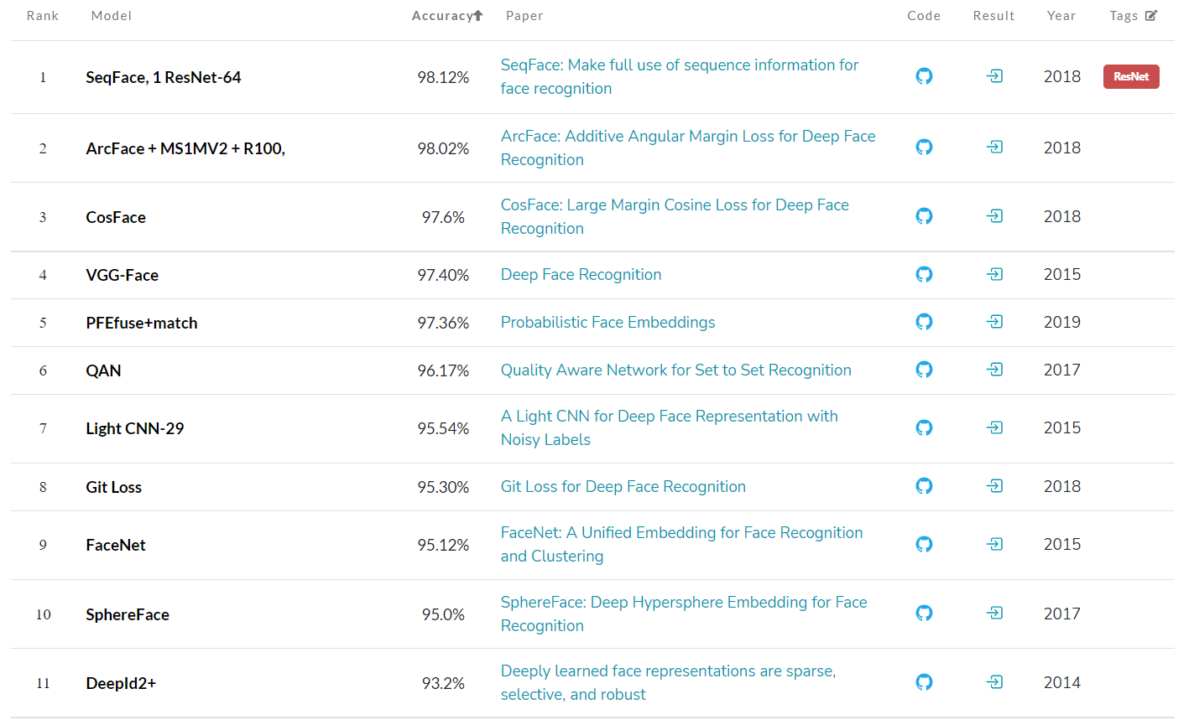

Slide 38
CASIA-WebFace
Used for face verification and face identification tasks.
494,414 face images of 10,575 real identities collected from the web.
Used for training the FaceNet Model.
You’ll see benchmarks in latter slides.

Slide 39
VGGFace2
Around 3.31 million images
Divided into 9131 classes
Each representing a different person identity.
Test suite contains around 170000 images divided into 500 identities while all the other images belong to the remaining 8631 classes available for training.
Very low label noise and a high pose and age diversity.
Have an average resolution of 137x180 pixels, with less than 1% at a resolution below 32 pixels.

Slide 40
Implementation

Slide 41
Loss function
Triplet Loss was described and used in the Facenet paper for training.
Currently, the best results are achieved by training the model using softmax loss.
Performance of other loss function such as cross-entropy, MSE, Triplet wasn’t as good as softmax loss.
Both Triplet loss and Softmax loss are implemented in the source code.

Slide 42
Face alignment using MTCNN
Dlib face detector misses some of the hard examples (partial occlusion, silhouettes, etc). This makes the training set to "easy" which causes the model to perform worse on other benchmarks.
Other face landmark detectors has been tested. One face landmark detector that has proven to work very well in this setting is the Multi-task CNN.
So MTCNN facial landmark detector is used.
Both Dlib and MTCNN are implemented in the source code.

Slide 43
ResNet Classifier
The paper also used the non-ResNet version of the Inception architecture.
These networks seems to be more difficult to train and does not converge very well when trained on the CASIA or Face scrub datasets. This can for example be seen as a relatively large loss on the training set also when no regularization is used, implying that the model is unable to overfit the data.
Training as a classifier makes training significantly easier and faster.
Using e.g. the Inception-Resnet-v1 solves the convergence problem and results in significantly improved performance on LFW, both looking at the accuracy and the validation rate.

Slide 44
Benchmarks
Note that training these models requires high computational power.
You can download pre-trained models and test it on LFW.
Train Dataset | Test Dataset | Test Accuracy | Download Weights
CASIA-WebFace | LFW | 0.9905 | Link
VGGFace2 | LFW | 0.9965 | Link

Slide 45
Running code

Slide 46
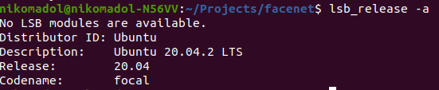
My Running Environment
Ubuntu 20.04 or 14.04
Python 3.5.10
Pip 20.3.4

Slide 47
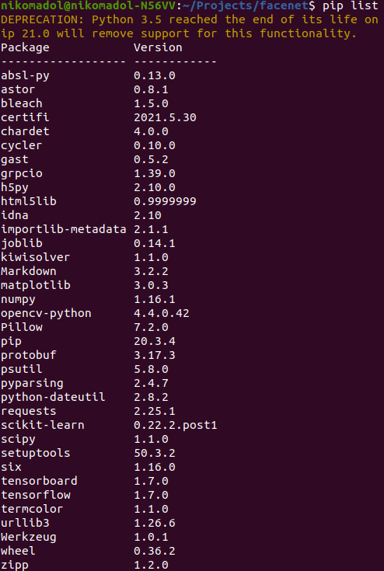
Requirements
tensorflow==1.7
scipy==1.1.0
scikit-learn==0.22.2.post1
opencv-python==4.4.0.42
h5py==2.10.0
matplotlib==3.0.3
Pillow==7.2.0
requests==2.25.1
psutil==5.8.0

Slide 48
Run
Using pre-trained VGGFace2 model
Test on a subset of LFW containing 307 images and 10 test

Slide 49
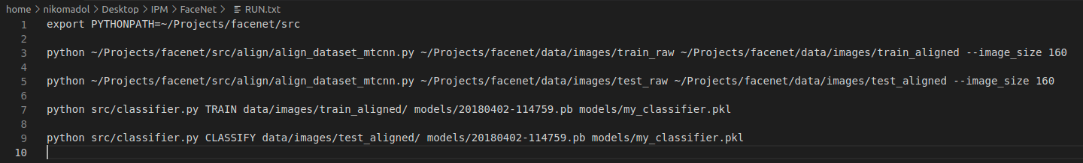
Commands
First copy facenet folder on ~/Projects
Then execute commands in RUN.txt file

Slide 50
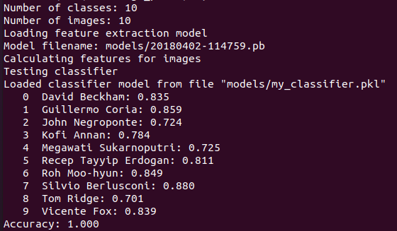
Results

Slide 51
FaceNet on FER-2013

Slide 52
Inception-ResNet
FaceNet classifier is an inception based residual network
There are 4 versions of Inception-ResNet:
Inception-Resnet-V1
Inception-Resnet-V2
Inception-Resnet-V3
Inception-Resnet-V4
We used version 2

Slide 53
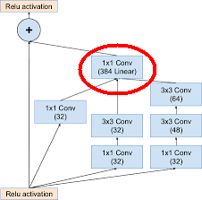
Residual Inception blocks

Slide 54
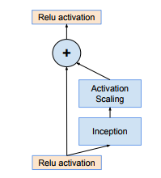
Scaling of Residuals

Slide 55
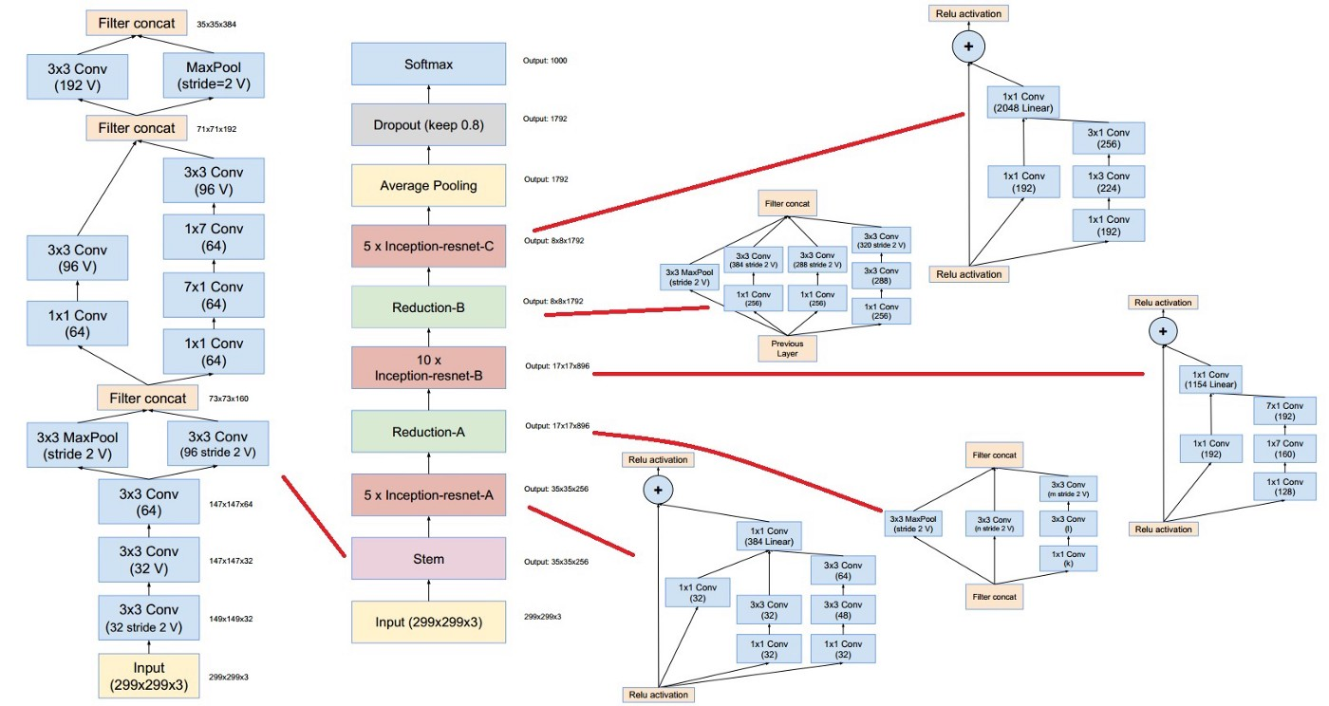

Slide 56
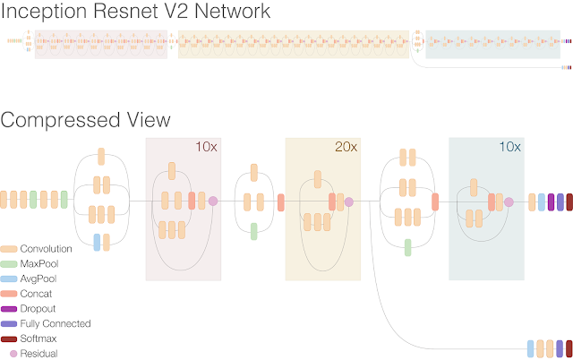

Slide 57
Number of parameters
Inception ResNet V2
Total params: 21,865,895
Trainable params: 21,809,831
Non-trainable params: 56,064
ResNet56:
Total params: 1,672,679
Trainable params: 1,662,279
Non-trainable params: 10,400

Slide 58
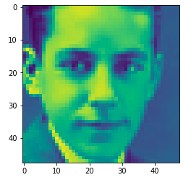
FaceNet + Augmentation
Train accuracy: 95.2 %
Validation accuracy: 63.1%
Link to Colab
Input: Original Image

Slide 59
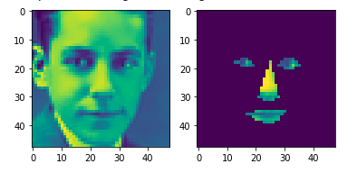
FaceNet + RoI Dlib + Augmentation
Train accuracy: 96.4 %
Validation accuracy: 66.7%
Link to Colab
Input: Original Image + Landmarks with Dlib

Slide 60
RoI Retina Face

Slide 61
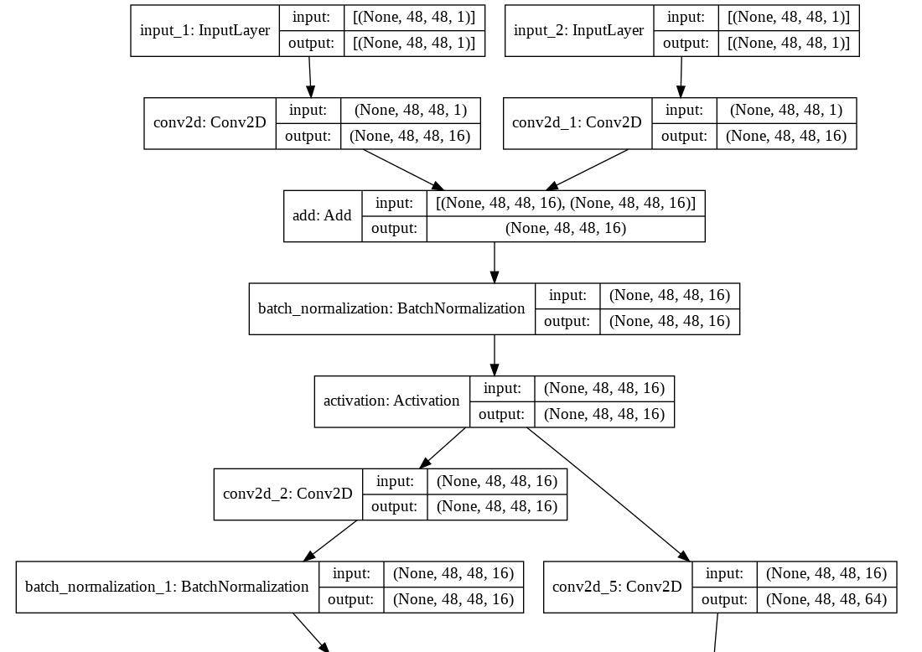
Original Input
RoI Mask
ResNet

Slide 62
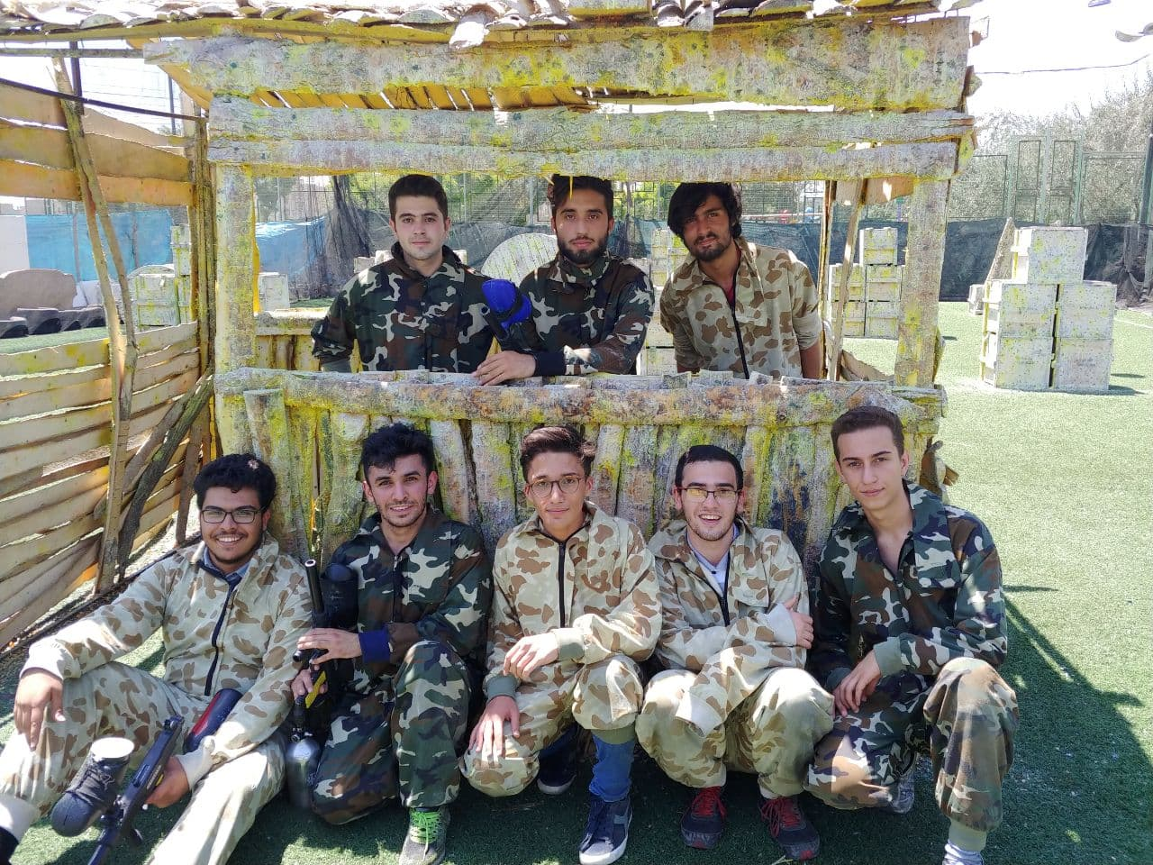

Slide 63








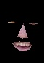
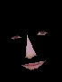
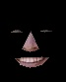
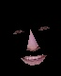
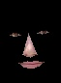
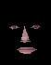
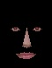
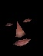
result for face 1: Happy
result for face 2: Neutral
result for face 3: Happy
result for face 4: Happy
result for face 5: Neutral
result for face 6: Neutral
result for face 7: Neutral
result for face 8: Neutral

Slide 64
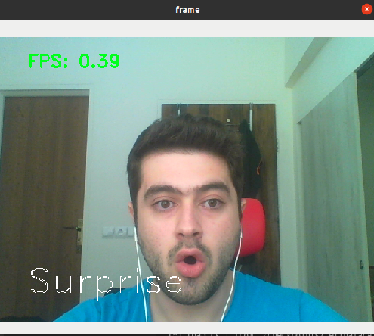
Webcam support

